Slide 1
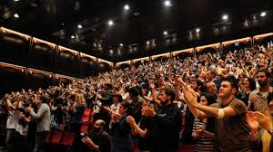

HomeSeeker X TutorTime 336 Presentation
“The Collab of The Century” - New York Times
“great product, an even greater team” - Local Man
HomeSeeker: Martin Lahoumh, Kevin Zheng, and Mazen Zarrouk
TutorTime: Michael Romashov, Joseph Platt, Tyler Ortiz, and James Zou

Slide 2


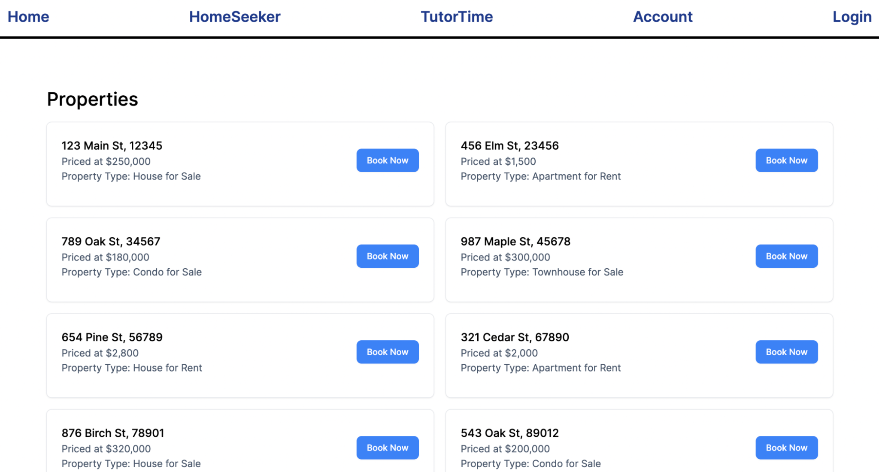

What is HomeSeeker?
Space where homeowners and homebuyers can traverse the real estate market more easily.
Homeowners register their homes and schedule available appointment times for buyers to select so that they can engage on a meeting about the potential home sale.

Slide 3


HomeSeekers Potential Revenue
With information that we gather about appointments being scheduled at certain locations, we will be able to find hot areas. From this information, we will sell to advertisers and real estate companies.
Additionally, in order to book an appointment, you will have to pay a small fee of $0.05 per minute to the broker and to USSSS!!!!!! :)

Slide 4

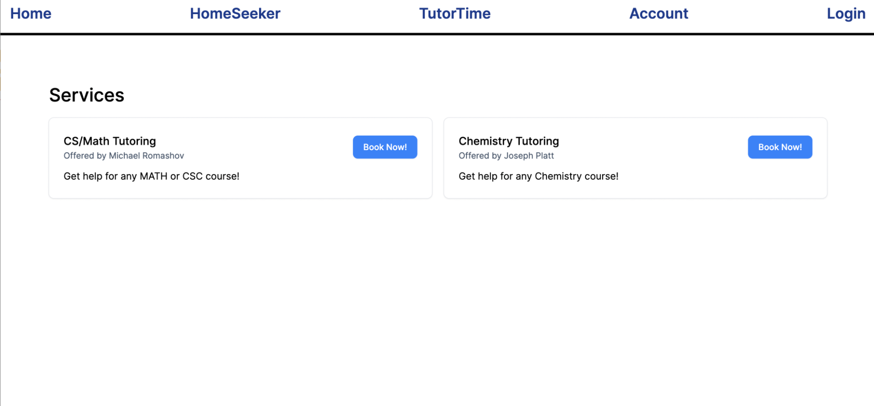

What is TutorTime?
TutorTime allows students to book appointments with tutors for certain subjects by selecting the service and a time
Other students can create new tutor services and set their availability
Booking a tutor requires a small fee

Slide 5

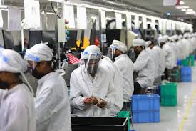
TechStack
The database chosen to work on was MySQL as it performes better than many other systems for smaller databases, while still providing a rich feature set
We create a fullstack app with NextJS to effortlessly create server-side function in our front-end code, while maintaining type safety through TypeScript
Docker Compose helps us build and configure our stack with ease and allows us to run all parts of our apps with one single command

Slide 6
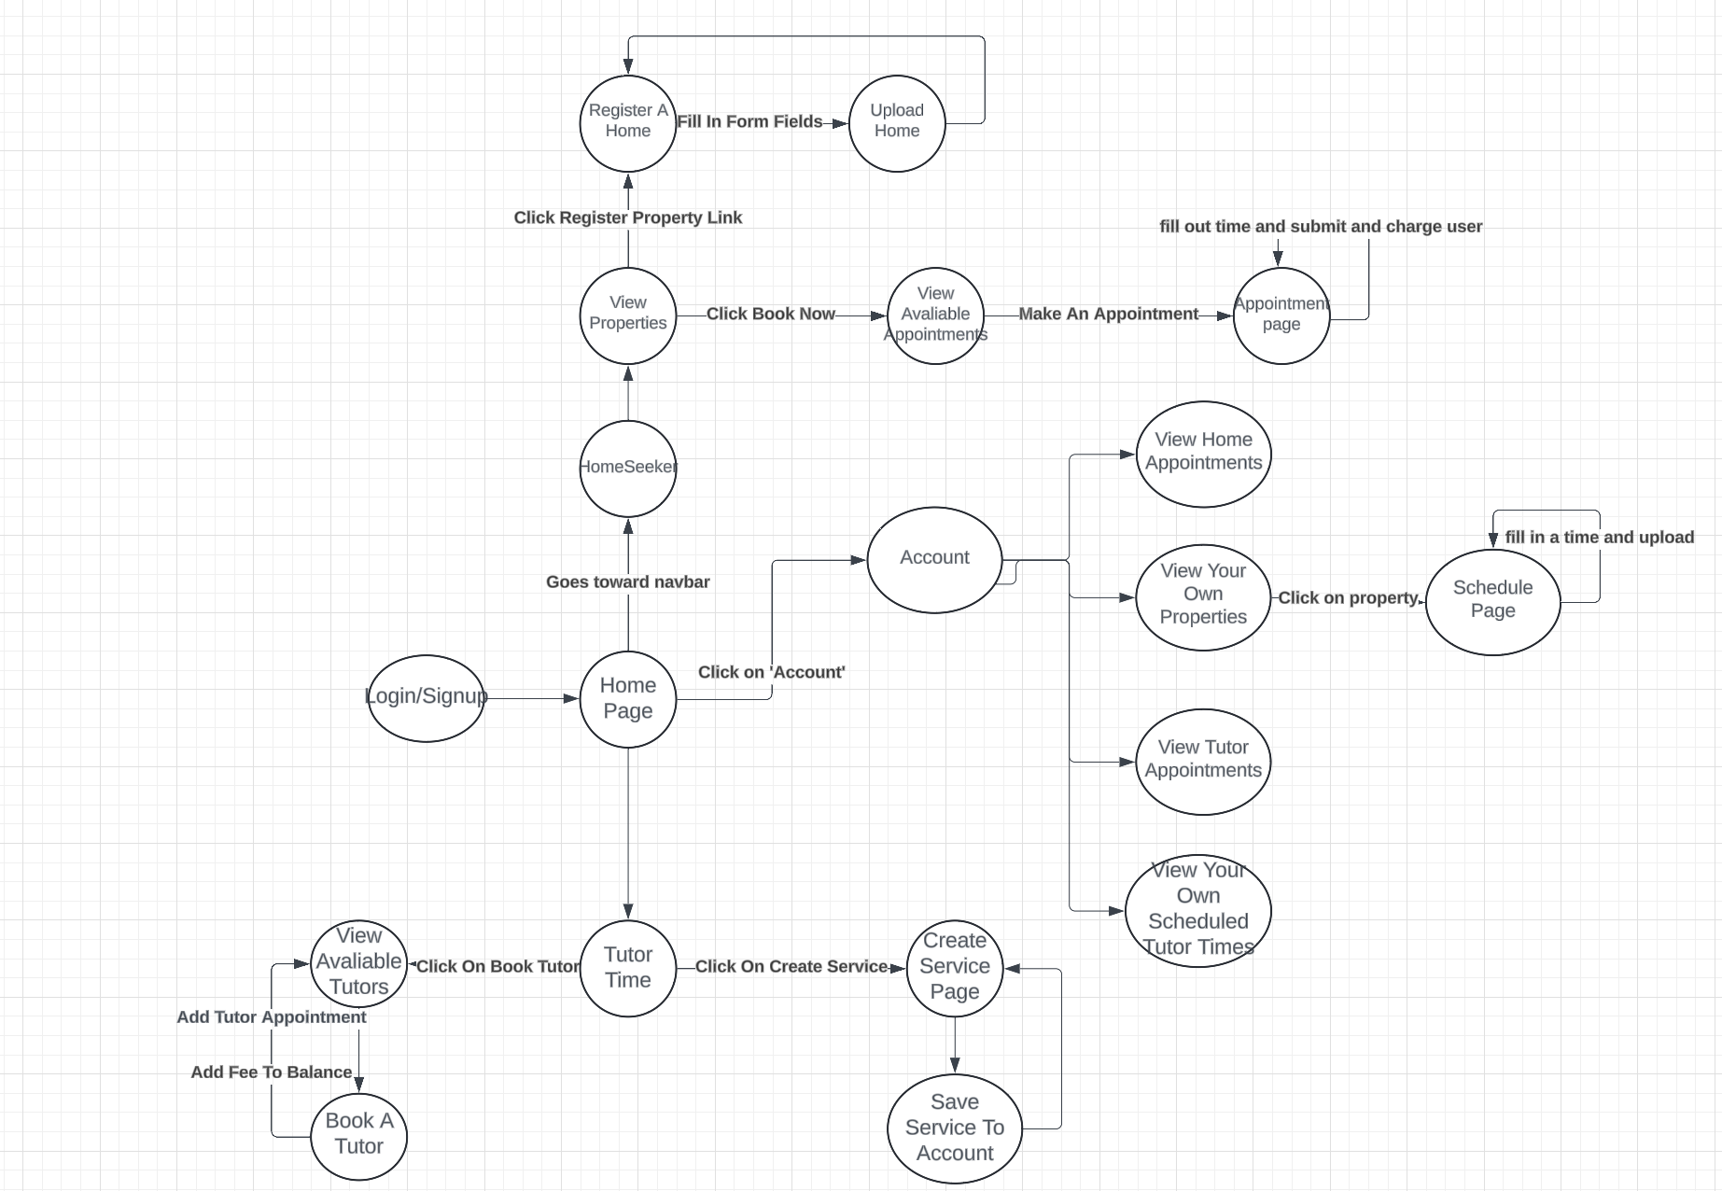
Use Case (using User Journey with Diagram)
User Journey Diagram

Slide 7
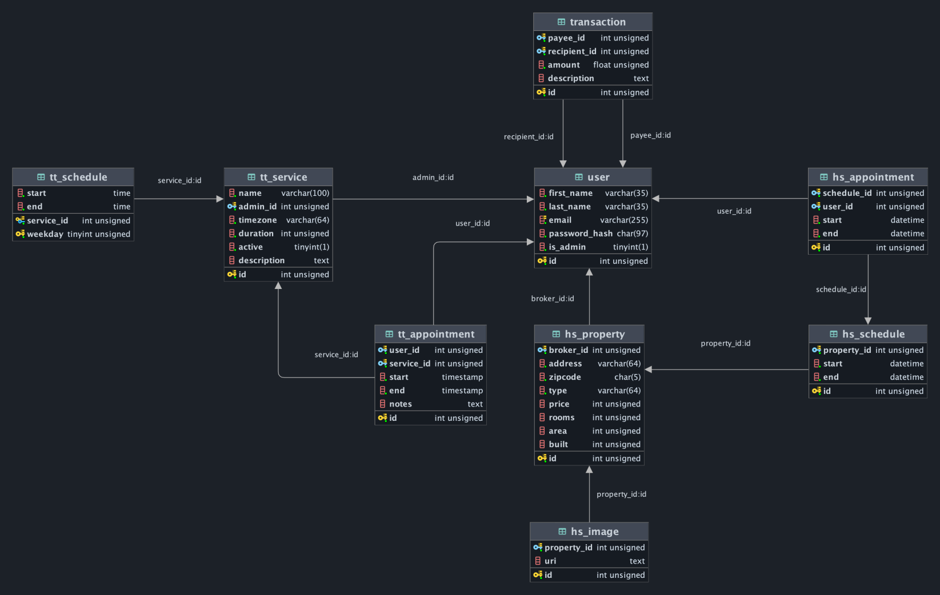
2NF Relational Model Diagram

Slide 8
Landing Page Demo
NOW REFER TO MIKE AND KEVIN FOR A LIVE PRESENTATION NOW REFER TO THEM NOW NOW !!!!! DO IT

Slide 9
Job Delegation and Team Work
Homeseeker
Kevin Zheng: Acted as the team's tech leader. Worked on main components of the page such as the appointments and booking and home page
Martin Lahoumh: Worked on home display page and scheduling and team management, laying out who would do what. Acted as an editor/debugger for other people's code as well as creating the power point presentation
Mazen Zarrouk: Acted as the team's main designer, doing the front end for components and prettying up the site. Would set reminders for the team and acted as a debugger

Slide 10
Job Delegation and Team Work
TutorTime
Tyler Ortiz: Worked on front end implementation and fixed bugs
Joseph Platt:
Michael Romashov:
James Zou:

Slide 11
Extra Credit Work
HomeSeeker: Team of 3 people (+5)
HomeSeeker & TutorTime: Web Based UI

Slide 12

Questions and Examination
QUESTIONS???? Don’t (DO ;) ) ask them. Thank You :)
Otherwise, cya

Slide 13
Submission for Grading
Submit your full project, incl. Diagram, Stored Procedures, Application, UI, Powerpoint for Demo, Via Github Classroom
https://classroom.github.com/a/XEAxMojc
Cut Off Time 5/11/2024 12:00 AM

